Slide 1
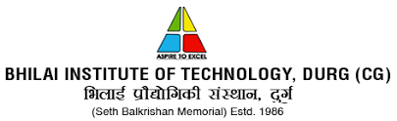

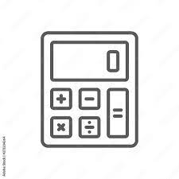
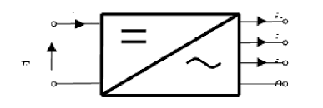
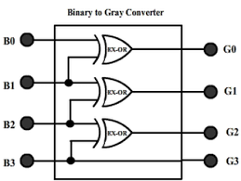
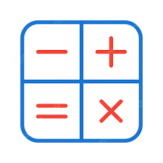
Department of computer science and engineering
Digital
Electronics
converter-
PRESENTED BY:
AMAN GUPTA-(A60)
DHEERAJ PATEL-(A65)
ADITYA SINGH CHAUHAN-(A66)
ARJUN KUSHWAHA-(A67)
CSE III-A
Guided by:
Prof. Revati Raman Dewangan
Prof. Usha Kiran
Group no:-10

Slide 2
Introduction
As, we have four types of number systems so each one can be converted into the remaining three systems. There are the following conversions possible in Number System
Binary to other Number Systems.
Decimal to other Number Systems.
Octal to other Number Systems.
Hexadecimal to other Number Systems.

Slide 3
PROBLEM STATEMENT
In digital electronics it is a very large and hectic task to convert the digits from various forms to another it becomes very difficult for the users to convert every bit of the number from one form to another which makes the work very slow and time consuming now also there are various ways to solve over problem but all of them are either paid and it requires a lot of practice to use them wisely the presently available solution does not specifically deals with just the conversions and digital electronic subject.

Slide 4
Objective
Our objective is to bring only those functions or formulas which just helps the student for there education purpose it helps them to convert the numbers from one to another very easily for there calculations we want have designed the sight specifically for the student and learners who requires it . The aim is to make a clutter free site for the user so there could be minimum or no confusion for the user

Slide 5





Software and Hardware Requirements
Any browser with Javascript enabled .
Any browser equipped with google chrome v8 engine .
Computer with Visual studio code/any code editor.

Slide 6
Reference
https://circuitverse.org/
https://www.geeksforgeeks.org/digital-electronics-logic-design-tutorials/
https://www.digitalelectronicsdeeds.com/
https://onlinecourses.nptel.ac.in/noc22_ee55/preview

Slide 7
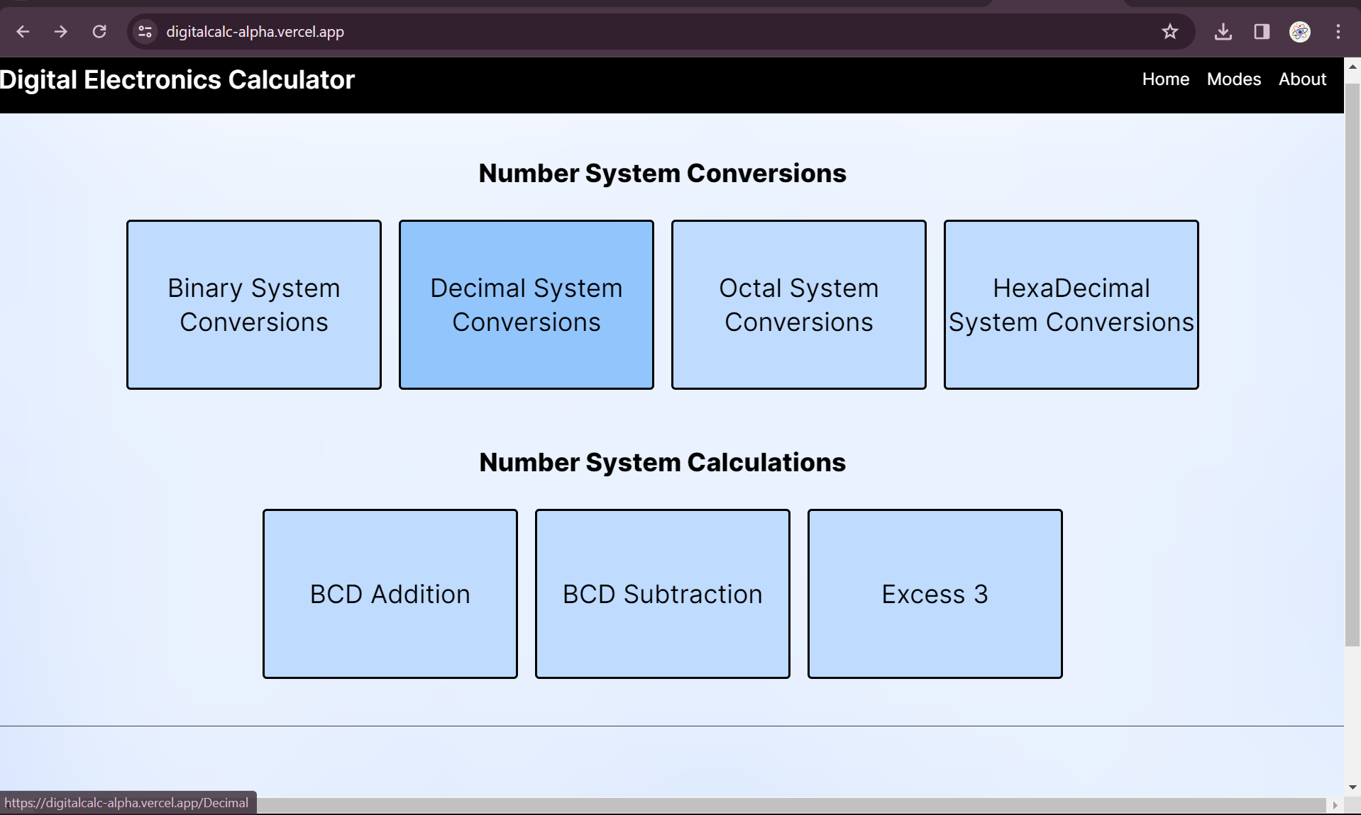
Preview site
https://digitalcalc-alpha.vercel.app/

Slide 8
Features
Our site basically in simple words is a converter /calculator which helps the user to simplify and accelerate their calculation related to digital electronics
The website is an free to use and publically available work space for the user it is a simplified version of the pre-existing solution for the conversion and mathematical operations based that are based on digital electronics
The user just need to select the type of operation he or she wanted to perform and then just he/she has to enter the digits .
The pre existing site or apps are just so much cluttered and un usable that it confuses the user so much that he is not able to find the correct solution which he/she needs at a particular instance.

Slide 9
OUTCOME
The outcome of our work is simple it will help to fulfil the user demand for conversion and calculation of all the digital electronics related numbers and will help to make the user more productive and get the output at the earliest and by the simplest way possible for him or her .
The website is alreasd hosted so a user needs just a device and an active internet connectivity to help himself/herself for any problem .
The user does not need any specific system requirement to use the calculator its just that any browser should be available for the operating system to access and use the website.

Slide 10
USER FLOW DIAGRAM
Output In Selected Format
ENTER INPUT AND GET OUTPUT
BINARY TO OTHER
Output In Selected Format
ENTER INPUT AND GET OUTPUT
DECIMAL TO OTHER
OCTAL TO OTHER
ENTER INPUT AND GET OUTPUT
Output In Selected Format
ENTER INPUT AND GET OUTPUT
Output In Selected Format
URL
https://digitalcalc-alpha.vercel.app/
SELECT METHOD
HEXADECIMAL TO OTHER
Output In Selected Format
BCD ADDITION
ENTER INPUT AND PRESS ADD
Output In Selected Format
ENTER INPUT AND PRESS SUBTRACT
BCD SUBTRACTOR
ENTER INPUT AND PRESS SUBTRACTION
Output In Selected Format
EXCESS-3

Slide 11
IMPORTANCE IN ENGINEERING
The project is based on the digital electronics calculation which is an important segment in the field of engineering as in every thing from a small wrist watch to the most used electronic devices all uses digital electronic logics and it is necessary for the designer to be precise and accurate in all the gates and calculation done in the circuit design and logic design as just a small error in the logic design can lead to a large error in the functioning of the whole device and can even lead to irregular results . Not only for designers and engineers the digital electronics calculation is also helpful for the engineering students for correcting their conversion logics by checking their answers before the exam to check if they have understood the topic and conversions correctly or not.

Slide 12
THANK
YOU

